Slide 1
FACIAL IMAGE INPAINTING
04-17-2023
Ayman Fahsi: A20440820
Mouhammad Bazzi: A20522180
CS512 - Spring 2023

Slide 2
Problem statement
The goal of this project is to produce a model that can accurately inpaint photorealistic Facial Images
Inputs will be high quality faces corrupted by an irregular mask
Outputs should be accurately inpainted regions with a high resolution

Slide 3
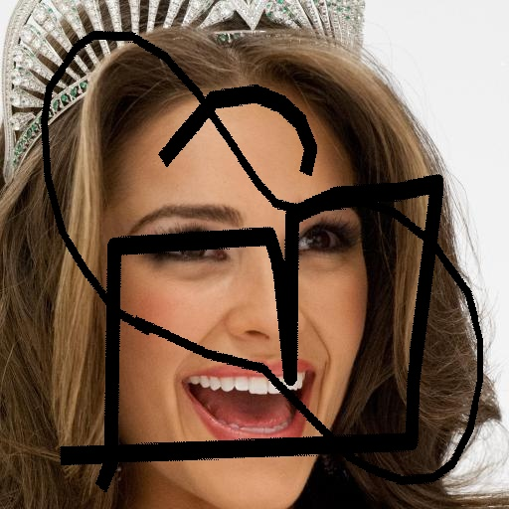
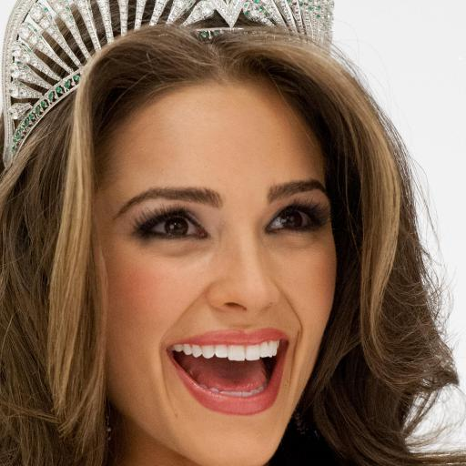
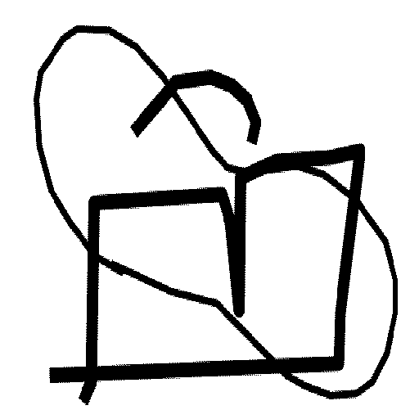
PROPOSED SOLUTION
Data Sets
CelebA_HQ
-
30,000 RBG
{1024x1024, 512x512}
QD-IMD
-
30,000 Gray-Scale Masks
{512x512}

Slide 4
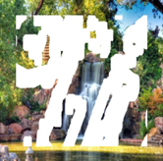
PROPOSED SOLUTION
Data Sets
NVIDIA IMD
-
30,000 Gray-Scale Masks
{512x512}
Places2
-
10,000,000 RBG
{365 Locations}

Slide 5
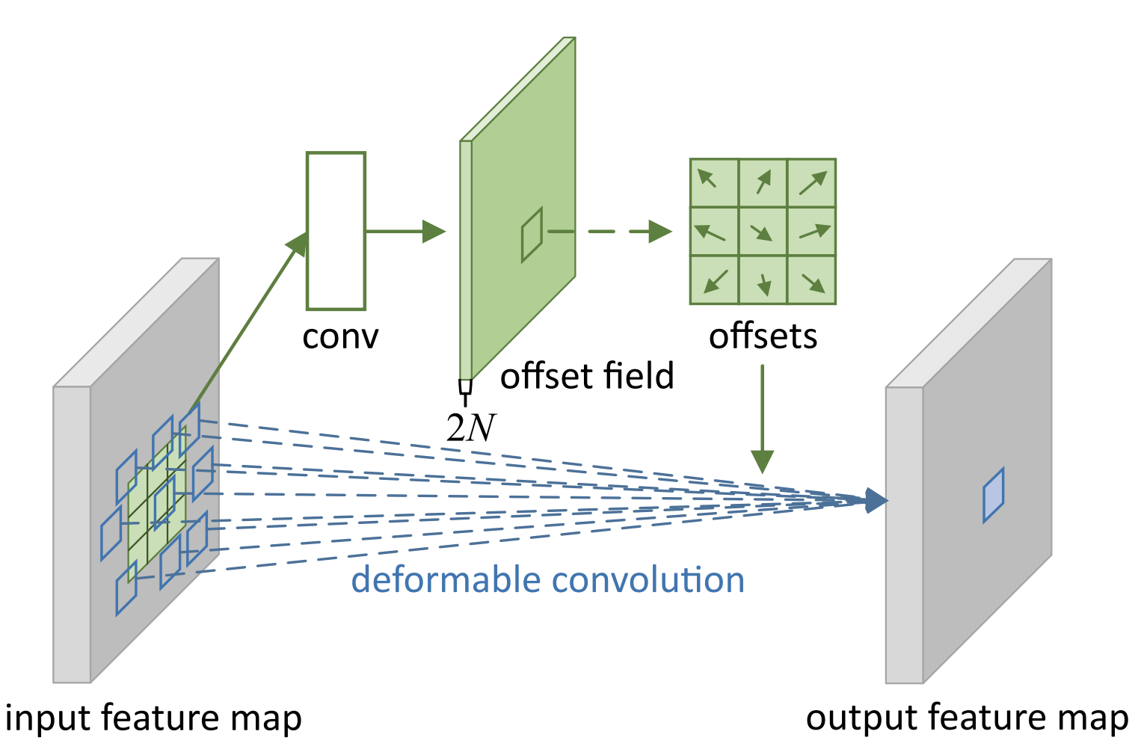
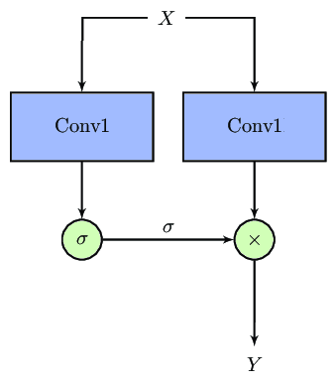
PROPOSED SOLUTION
Convolutional Layers
DEFORMABLE CONVOLUTION
GATED CONVOLUTION
Pros: Improved flexibility and adaptability to complex patterns
Cons: Increased computational complexity and training time
Pros: Better control over information flow and increased expressiveness
Cons: Additional computational cost and complexity due to gating mechanism

Slide 6
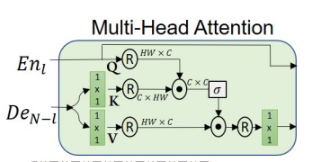
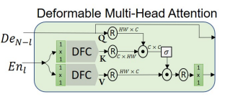
PROPOSED SOLUTION
Deformable Multi-Head Attention
Deformable Multi-Head Attention (DMHA) is more flexible in capturing information:
DMHA allows the network to learn the spatial locations of the features
(i.e. enable the model to focus on specific regions)

Slide 7
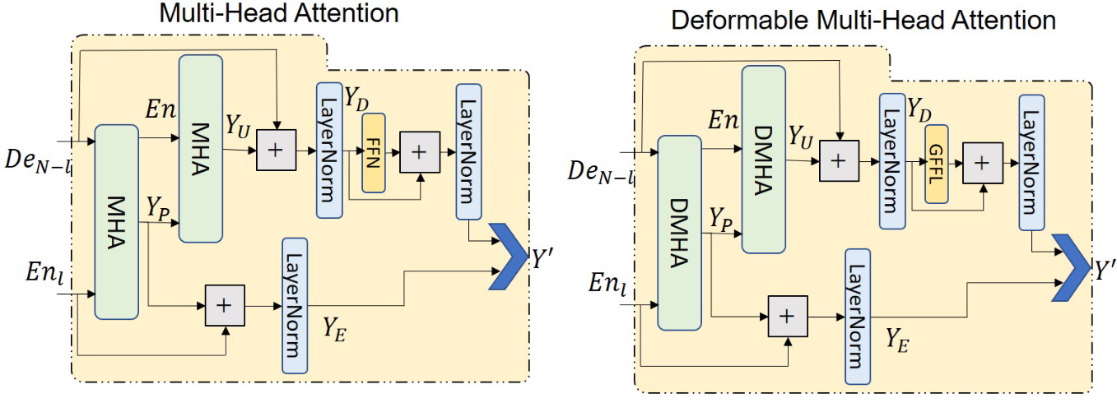
PROPOSED SOLUTION
Nested Deformable Multi-Head Attention

Slide 8
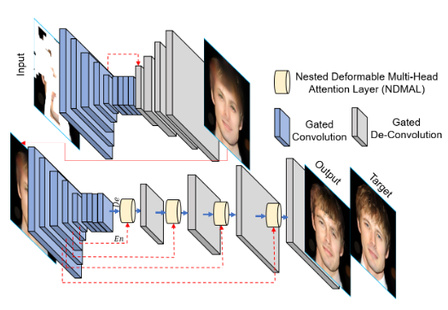
PROPOSED SOLUTION
Main Architecture, Loss & Metrics
Loss
Model Architecture
L1 Loss | Adversarial Loss | Perceptual Loss | Edge Loss
Better reconstruction of the image | Generation of Globally and Locally consistent realistic image | Textural and structural information | Edge enhancement
Metrics
PSNR | SSIM | L1 Loss | LPIPS | FID
Measures the quality of reconstructed images | Evaluates the similarity between two images by considering luminance, contrast, and structure | absolute differences between images | measures the perceptual similarity between two images | evaluate the quality of generated images
Input: Corrupted Image concatenated with the Mask
Output: Inpainted Image

Slide 9
Implementation DETAILS
Small Issues
9
Datasets
The NVIDIA IMD dataset was not publicly available and Places2 datasets was too large for our hardware to handle
→ We decided to use CelebA_HQ corrupted by QD-IMD masks
We had issues using the CelebA_HQ dataset generation script provided by TensorFlow
→ We downloaded the prepared files onto our local machines via Google Drive link
Deformable Convolution (DC)
Issues in implementing DC on TensorFlow or using already implemented DC solutions
→ We decided to switch all our code from TensorFlow to PyTorch

Slide 10
Implementation DETAILS
Main Issues
10
Model Divergence
Loss equals NaN after seeing one image
→ Reduced Learning rate (improved a little but still Diverge super quickly)
→ Probably because of imperfection in the way we implemented the model
Insufficient computational power
Using Colab GPU: Training one image takes 15 seconds
→ So training 500 images (paper used 30,000) using 10 epochs (paper used 200) ≈ 21 hours of training
UNABLE TO TRAIN

Slide 11
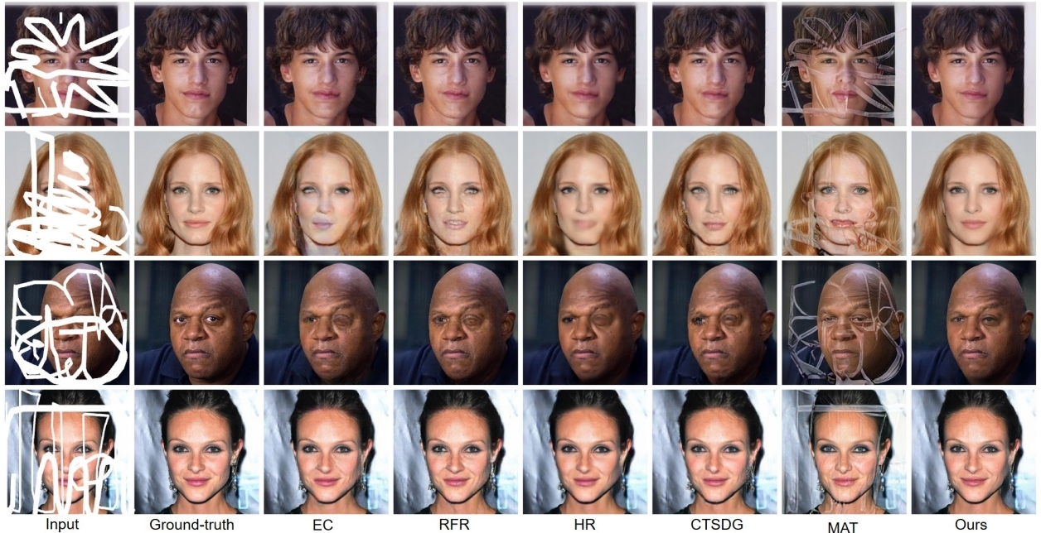
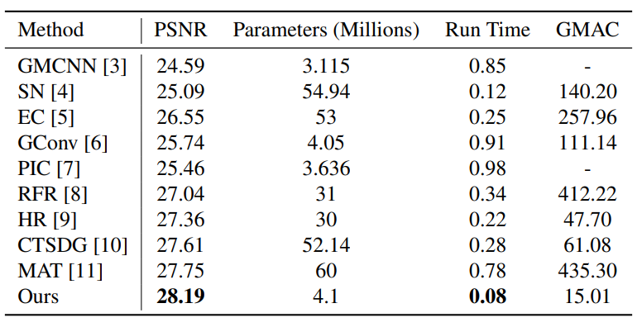
Results & DISCUSSION
Expected Results
11
Benchmark comparison of proposed and existing (performance comparison)
Benchmark comparison of proposed and existing models (outputs comparison)

Slide 12
References
12
[1] Shruti S Phutke and Subrahmanyam Murala. Nested Deformable Multi-head Attention for Facial Image Inpainting. CVPR Lab, Indian Institute of Technology Ropar, https://openaccess.thecvf.com/content/WACV2023/papers/Phutke_Nested_Deformable_MultiHead_Attention_for_Facial_Image_Inpainting_WACV_2023_paper.pdf, 2023.
[2] Ziwei Liu, Ping Luo, Xiaogang Wang and Xiaoou Tang. Large-scale CelebFaces Attributes (CelebA) Dataset. Multimedia Laboratory, The Chinese University of Hong Kong, https://mmlab.ie.cuhk.edu.hk/projects/CelebA.html, 2020.
[3] Tero Karras, Timo Aila, Samuli Laine, Jaakko Lehtinen, Progressive Growing of GANs for Improved Quality, Stability, and Variation. ICLR, https://github.com/tkarras/progressive_growing_of_gans, 2018.

Slide 13
THANK YOU FOR YOUR ATTENTION
13

